Slide 1


The Effect of Climate Change and Closures on Fishers Portfolios:
Substitution between Coastal Pelagic Species
Felipe J. Quezada
UC Santa Cruz
NOAA Southwest Fisheries Science Center
November 3rd, 2021

Slide 2

California Current System (CCS)
Unique ecosystem
Provides many ecosystem services
Home to many protected species
Sustains commercial and recreational fisheries:
Forage species
Coastal Pelagic Species
Illustration by Fiona Morris
Notes:
Coastal Pelagic Species refers to the group of species included in the Pacific Fishery Management Council’s
Coastal Pelagic Species Management Plan (https://www.fisheries.noaa.gov/management-plan/coastal-pelagic-species-management-plan)

Slide 3
Coastal Pelagic Species in CCS
Pacific sardine:
Market squid:
Northern anchovy:
CPS SAFE: “In 2012, PSDN fishers shifted to squid during the summer due to low abundance”
Closure in 2015.
Limited Entry since 2002
High prices
Highly variable biomass driven by oceanographic
Low prices and landings
Record high abundance since 2017
“Partial substitute for sardine when its collapsed”
Affected by oceanographic variability
High landings, but decreasing in recent years.
Reduction quota in place
Notes:
1- Warm ocean cycle favors sardine and reduce anchovy, though there are exceptions, such as during the recent ‘warm blob’ heatwave.
2 – Squid may actually be a better substitute in terms of the fleet.
3- Important bait species for recreational fisheries
- Include fisheries background??? (trip scenario)

Slide 4
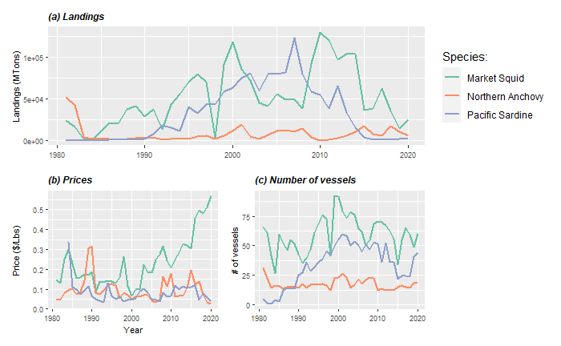
Trends in CPS fishery
Species abundance?
Market conditions?
Hypothesis:
Species abundance have decreased
Participation decrease when a species is under closure
Income diversification (Kasperski & Holland, 2013)
High prices for squid
But, decrease of number of vessels for market squid
Notes:
WHAT IS BEHIND THIS TRENDS

Slide 5
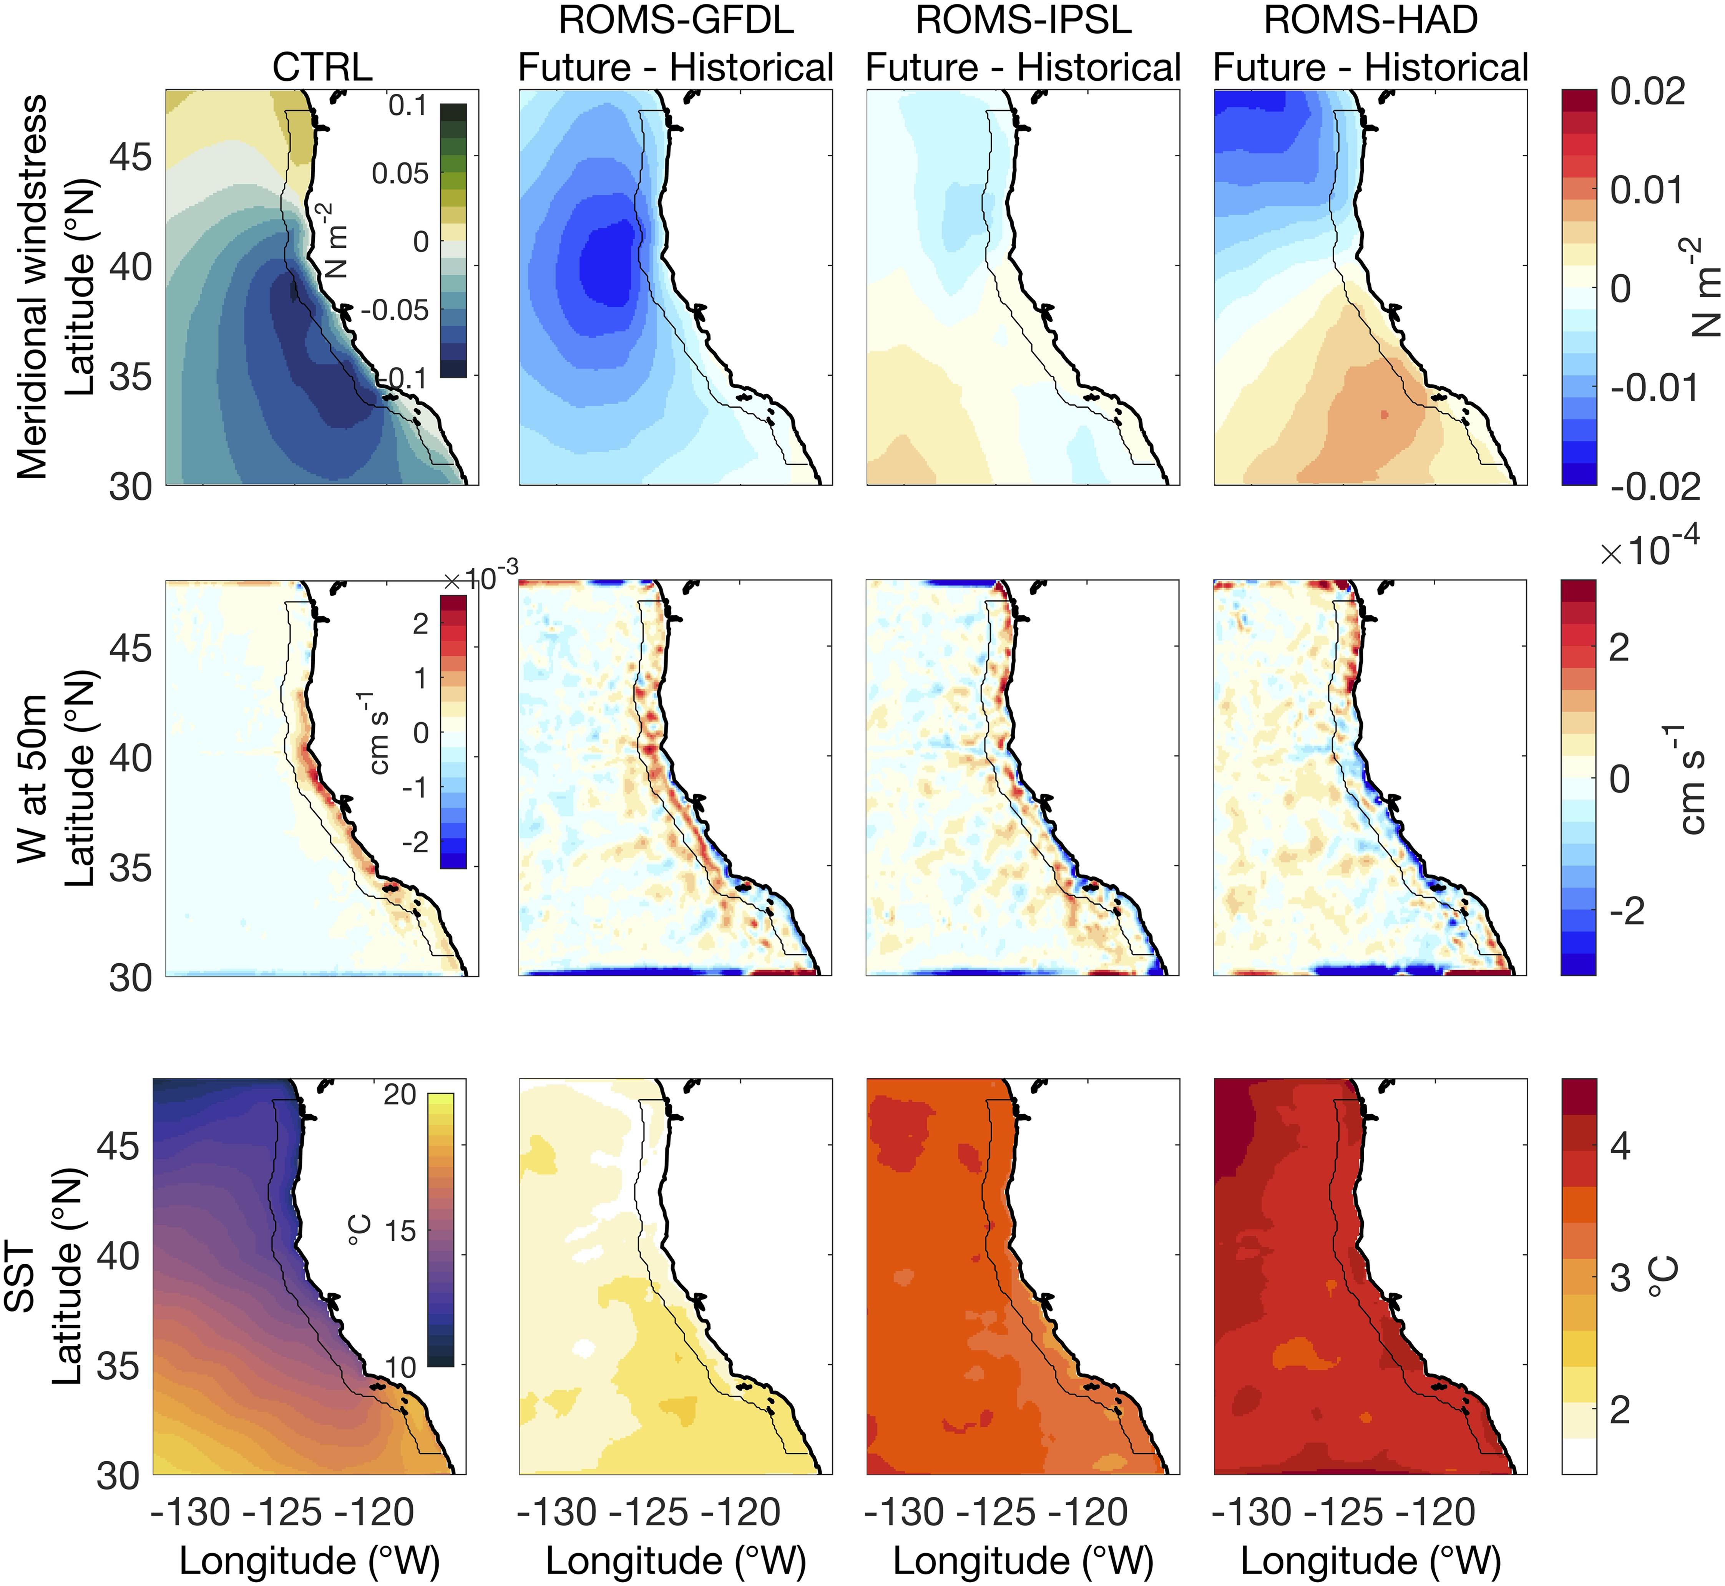
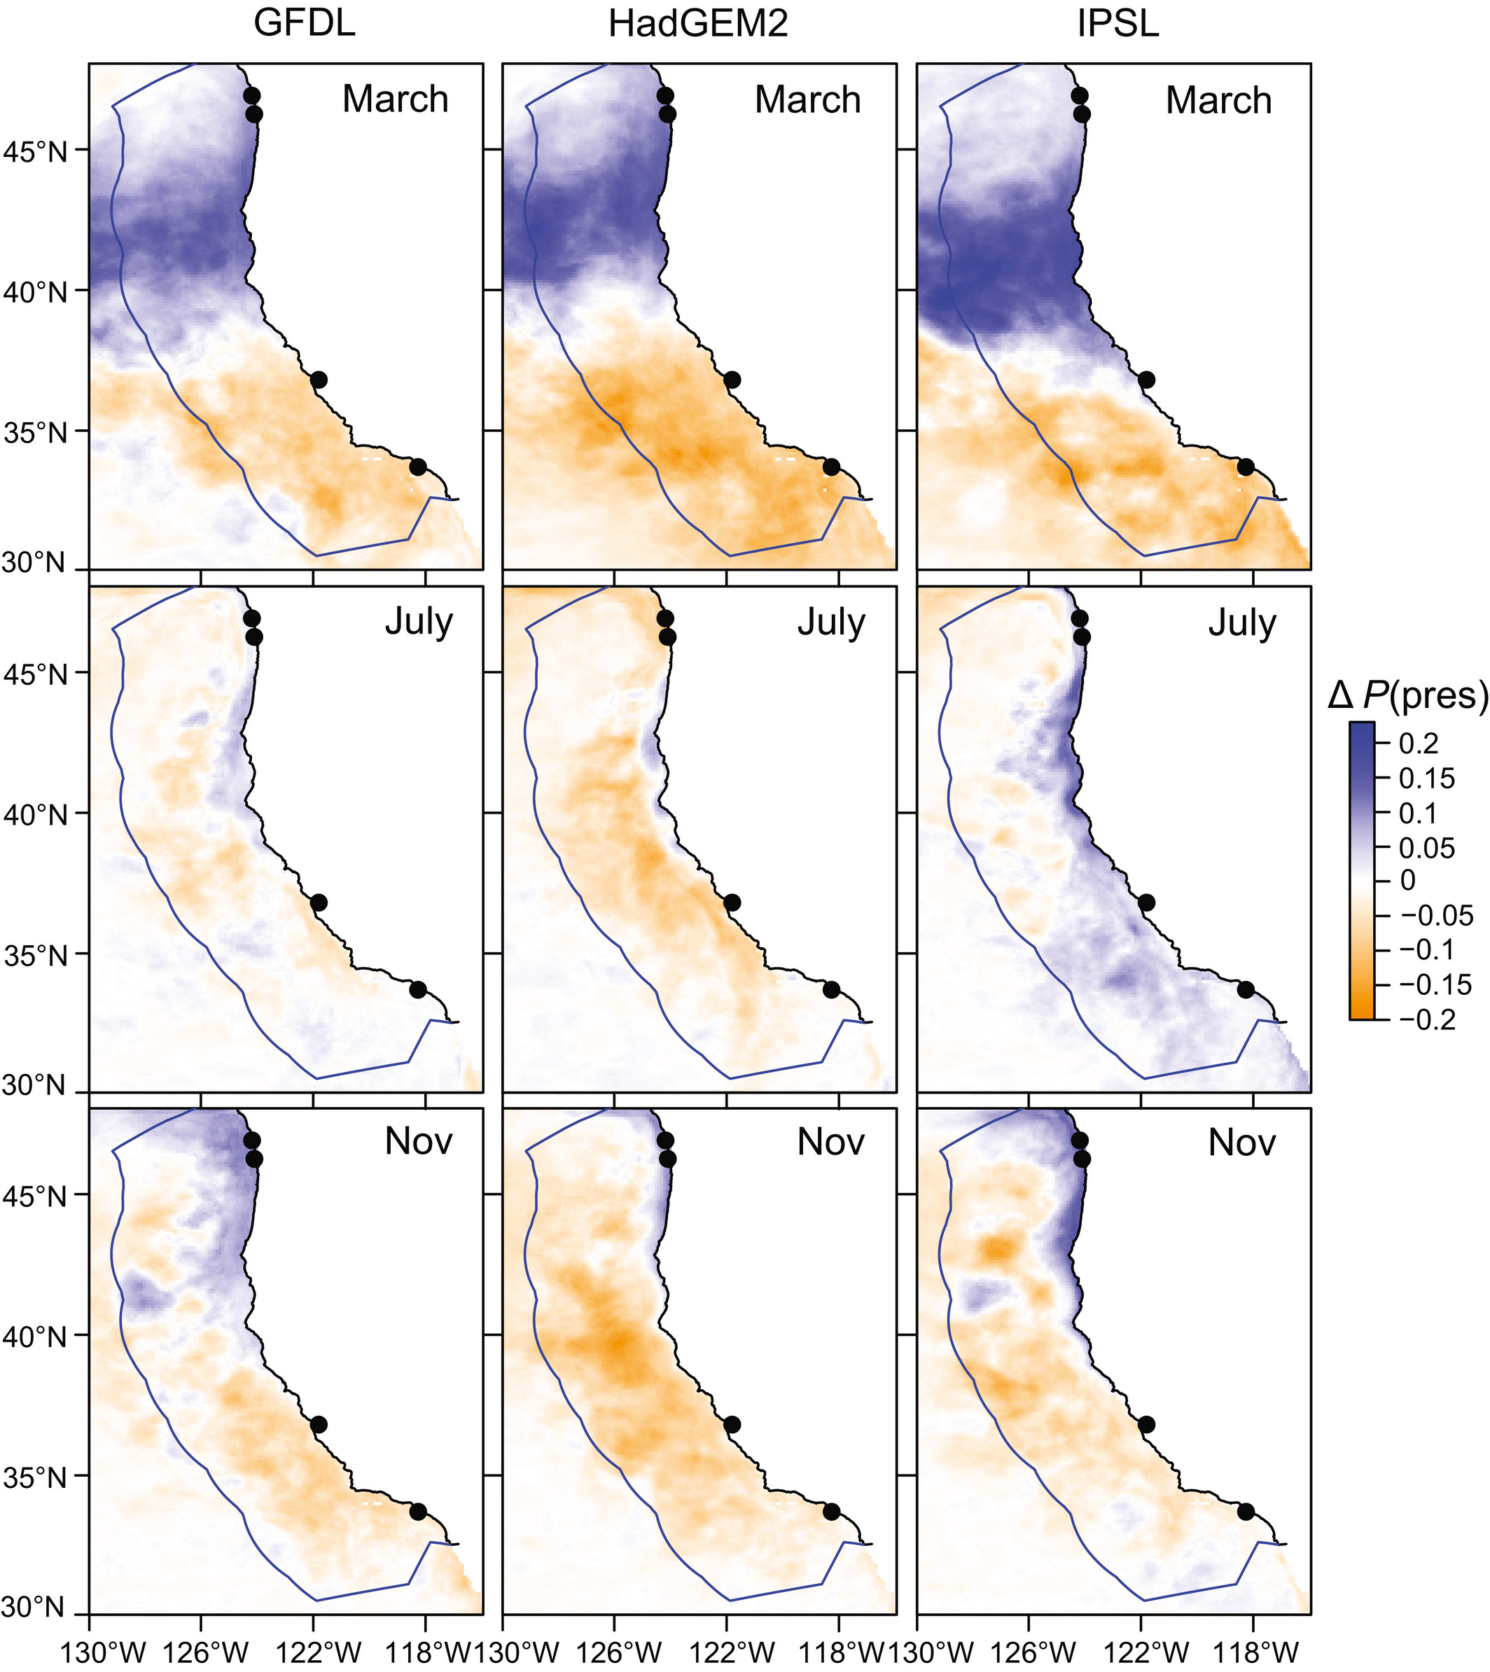
Climate is changing!
For instance, projected changes in Pacific sardine distribution
Source: Pozo Buil et al. (2021)
Figure. Mean change in projected sardine habitat suitability (2040–55 period minus 2000–2015 period), in the three ESMs. Source: Smith et al. (2020)

Slide 6
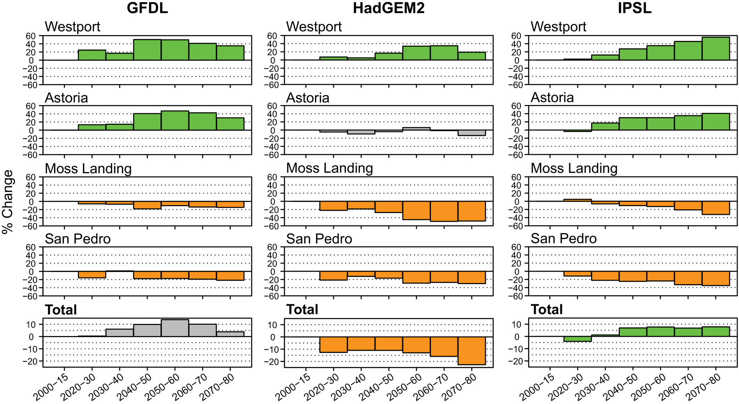
Effect on landings
Source: Smith et al. (2020)
Smith et al. (2020) found a positive effect of species distribution on Pacific sardine landings.
Changings on distribution could also trigger changes in regulation (e.g. closures)

Slide 7
Research Question
How will climate change impact fishing communities?
Specific questions:
How do changes in species distribution and regulations (i.e. closures) affect landings and vessel participation in the multispecies Coastal Pelagic Species (CPS) fishery?
Contribution:
Previous work has focused on one species
Important to study other species and their interactions in fishers’ portfolio to assess climate impacts on CPS fleet.
Presence of other species might impact targeting decisions.

Slide 8
Methodology
Two approaches
Landings model (results using public aggregate data).
Participation model (no results yet).
Data
Fish tickets from The Pacific Fisheries Information Network (PacFIN) from 1980-2020
Fishing locations from logbooks
2000-2020, but depend on species
Maybe I can use Global Fishing Watch (2012-2020)
Current and projected species distribution from Species Distribution Models (SDMs) from 1997-2018

Slide 9
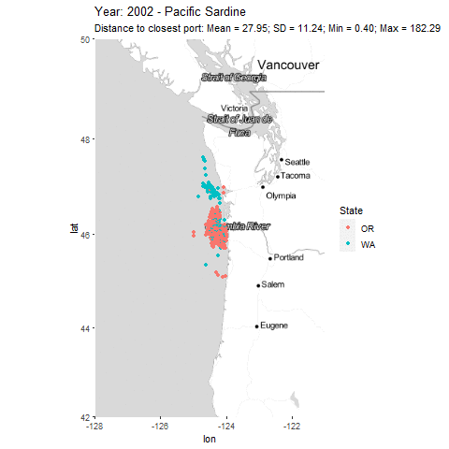
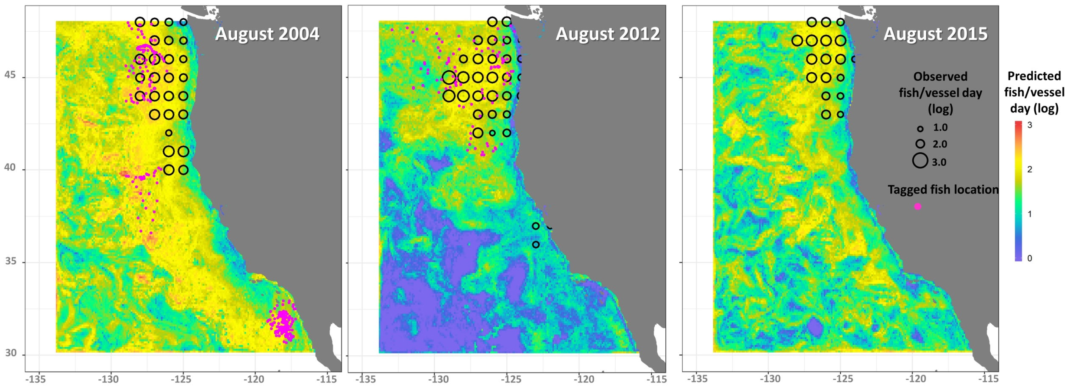
Species Distribution Model (SDM)
SDMs to model distribution of sardine, anchovy, market squid, herring (Muhling et al. 2019, 2020, Brodie et al. 2021)
SDM are at the 0.1 degree of resolution.
We use port radius to construct our variable of abundance
Fishery operates close to shore
Mostly undergoing daily trips
Problem with selection

Slide 10
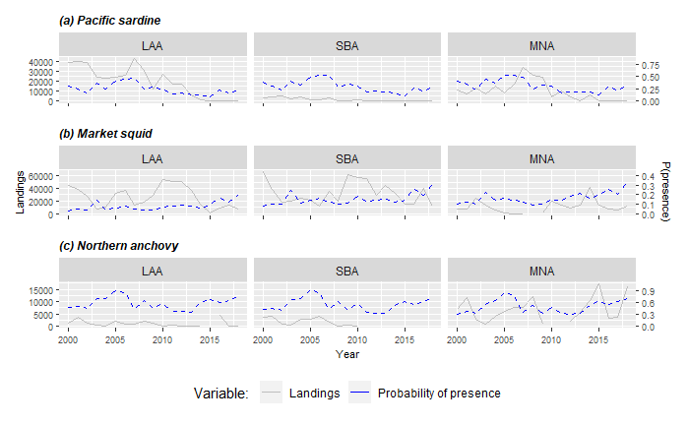
SDMs and Landings

Slide 11
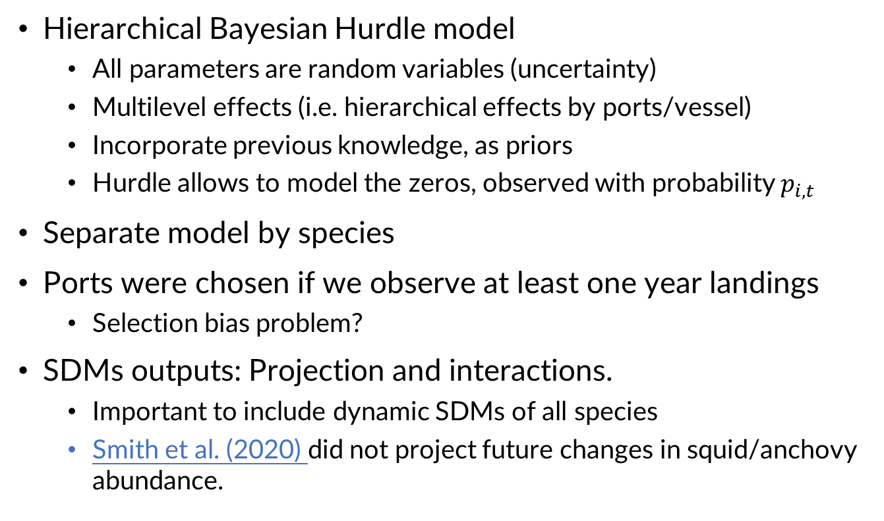
Landing model
Hierarchical Bayesian Hurdle model
All parameters are random variables (uncertainty)
Multilevel effects (i.e. hierarchical effects by ports/vessel)
Incorporate previous knowledge, as priors
Hurdle allows to model the zeros, observed with probability $p_{i,t }$
Separate model by species
Ports were chosen if we observe at least one year landings
Selection bias problem?
SDMs outputs: Projection and interactions.
Important to include dynamic SDMs of all species
Smith et al. (2020) did not project future changes in squid/anchovy abundance.
Notes:
Talk that ports were selected if we observe landings of the species in consideration.
Q: Felipe, you are looking at distribution of fishing locations and fish caught and landed in those locations as opposed to some objective level of abundance and distribution, right? The data are fishery dependent, and hence there is potential endogeneity and sample selection bias both in the choice of fishing and landngs but using a port in the first place from historical data, all from logbook data. S
So, these are abundance not as if from a random selection across all areas.
R: No, I'm looking just landings, this questions is for the discrete choice model for locations. Regar to selection bias, you are right.

Slide 12
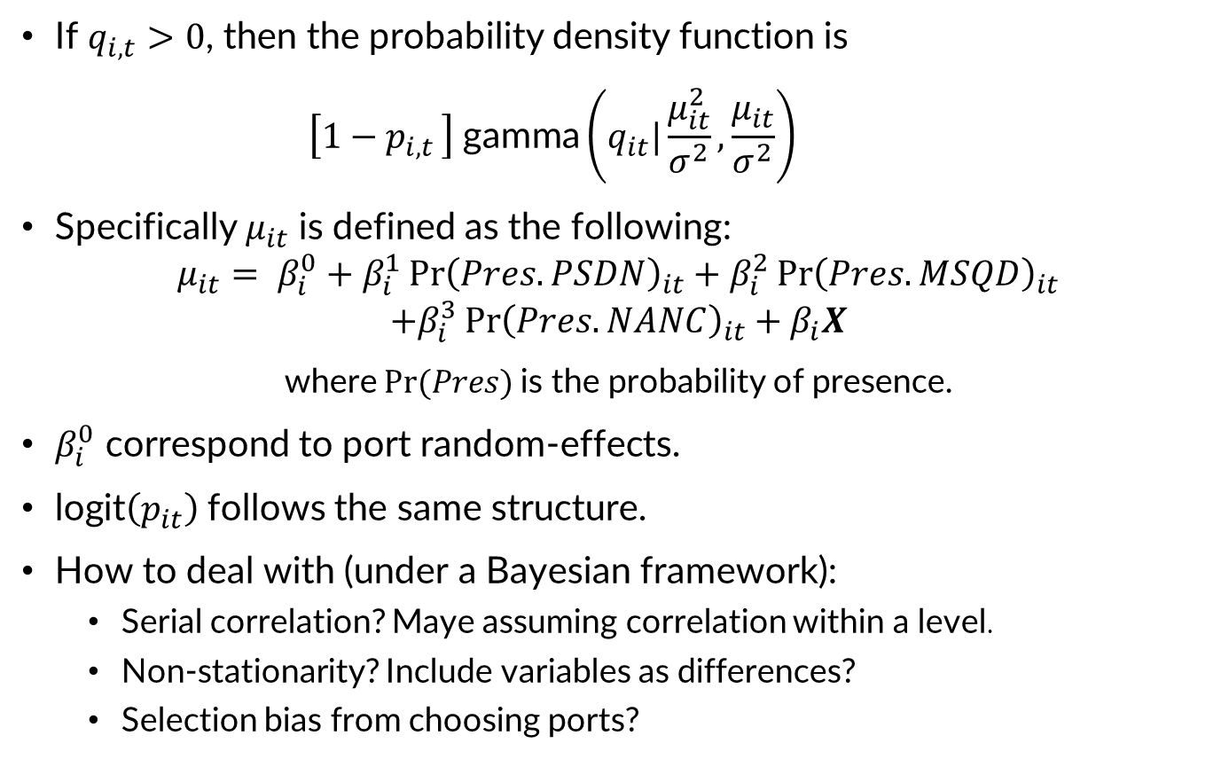
Methodology
If $q_{i,t}>0$, then the probability density function is
$$\left[1−p_{i,t }\right] \text{gamma}\left(q_{it}|\frac{μ_{it}^{2}}{σ^{2}},\frac{μ_{it}}{σ^{2}}\right)$$
Specifically $μ_{it}$ is defined as the following:
$$μ_{it}= β_{i}^{0}+β_{i}^{1}{\operatorname{Pr}\left(Pres.PSDN\right)}_{it}+β_{i}^{2}{\operatorname{Pr}\left(Pres.MSQD\right)}_{it}$$
$$+β_{i}^{3}{\operatorname{Pr}\left(Pres.NANC\right)}_{it}+β_{i}X$$
where $Pr(Pres)$is the probability of presence.
$β_{i}^{0}$ correspond to port random-effects.
$\text{logit}\left(p_{it}\right)$follows the same structure.
How to deal with (under a Bayesian framework):
Serial correlation? Maye assuming correlation within a level.
Non-stationarity? Include variables as differences?
Selection bias from choosing ports?
Notes:
Random effect model, similar to panel data model.
Dale Squires:
Did you do any cointegration analysis beforehand to check for any potential spurious regression?
A: When I have monthly time series.
Dale Squires:
Q: Does potential serial correlation arise with these types of regressions?
A: I have to check!
Q: Do ENSO events create a structural break in the time series that must be controlled for?
A: Should be included in SDMs

Slide 13
Methodology
Additional explanatory variables:
Annual Catch Limits (ACL)
Dummy variable for closure (Sardine models estimate before closure)
Annual landing prices by port
Likely to be exogenous as the US small exporter
Average distances traveled (To be included)
May be endogenous as further fishing areas might be more suitable for fishing
Congestion externality (Huang & Smith, 2014)
Fuel prices (To be included)
Weather events that affect fishers (To be included)
Storm warning by port
Winds and current at 0.1 degree of resolution
Endogeneity?
Bayesian IV literature
Notes:
Dale Squires:
Q: Does potential serial correlation arise with these types of regressions?
A: I have to check!
Q: Do ENSO events create a structural break in the time series that must be controlled for?
A: Should be included in SDMs
Q: distance and cost can be viewed as endogenous. distance would be chosen at the same time as location. many view location as a descriptor but the choice of that descriptor can be viewed as endogenous or simultaneously chosen with locaton.
A: In a discrete choice model
Stephen Stohs:
Potential solution: Use SDM model predictions as an instrumental variable for predicting fishing location choice... (????)

Slide 14
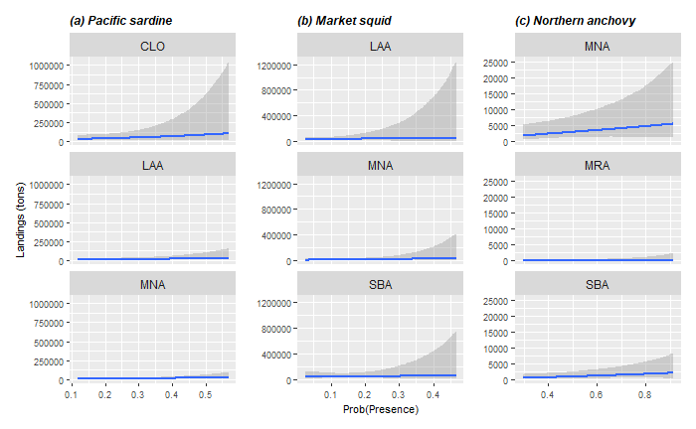
Results: Landings positively related to probability of presence

Slide 15
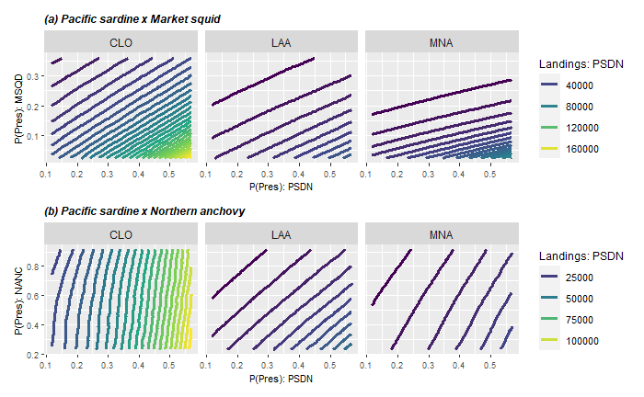
Results: Squid is a substitute of sardine
Notes:
Take your time in describing these complex plots.
Change from acroynms to words or names.

Slide 16
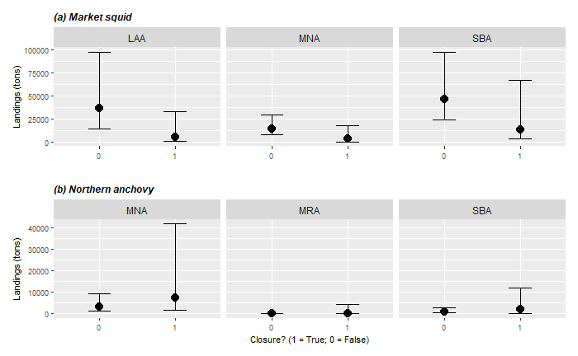
Results: Sardine closure reduce squid landings
Notes:
Verbally talk about confounding of environment similarly affecting squid and sardine dynamics sardine was closed in 2015 and 2015 was also a low year in terms of squid during ENSO.
It should be solve though when we include SDM for market squid.
Replace port codes with names.

Slide 17
Conclusions
Slightly positive effect of presence on landings.
Substitution between market squid and Pacific sardine.
Closure reduce market squid landings. Is this because of a lower participation in fishing?

Slide 18
Future work
Incorporate individual data for landings.
Check whether a vessel can switch between species or ports.
Vessels/port landings.
Vessel/port hierarchal effects.
Econometrics:
Serial Correlation
Non-stationarity
Selection Bias
How to test them in a Bayesian framework??
Estimate a discrete choice model for participation.
Forecast landings & participation using SDM projections.

Slide 19
Thanks for your attention!
Felipe J. Quezada
Postdoctoral Scholar
UC Santa Cruz & NOAA-SWFSC
felipequezada.com
felipe.quezada@noaa.gov

Slide 20
CAFA Project
NOAA’s Climate and Fisheries Adaptation (CAFA) program:
Supports targeted research to promote sustainable management, adaptation and resilience of the nation’s valuable fish stocks and fisheries-dependent communities in a changing climate
More information here

Slide 21
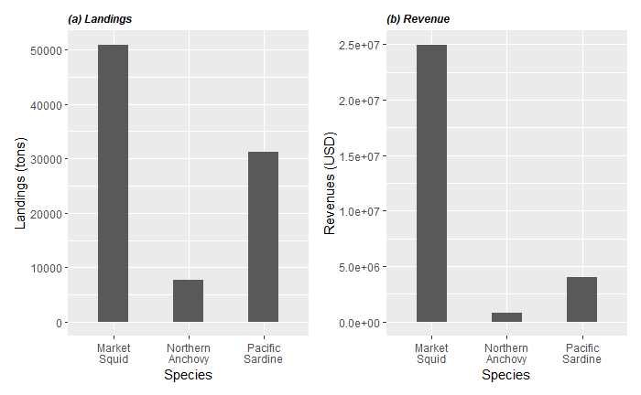
Coastal Pelagic Species in CCS
Period: 1980-2020
Notes:
SEINE is the main Gear used by this fleet.

Slide 22
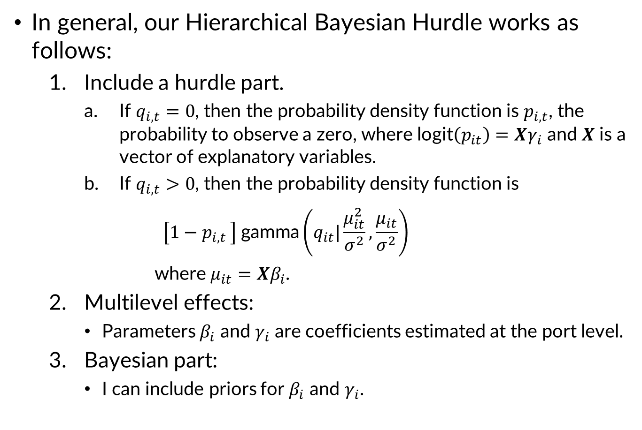
Methodology
In general, our Hierarchical Bayesian Hurdle works as follows:
Include a hurdle part.
If $q_{i,t}=0$, then the probability density function is $p_{i,t}$, the probability to observe a zero, where $\text{logit}\left(p_{it}\right)=Xγ_{i}$ and 𝑿 is a vector of explanatory variables.
If $q_{i,t}>0$, then the probability density function is
$$\left[1−p_{i,t }\right] \text{gamma}\left(q_{it}|\frac{μ_{it}^{2}}{σ^{2}},\frac{μ_{it}}{σ^{2}}\right)$$
where $μ_{it}=Xβ_{i}$.
Multilevel effects:
Parameters $β_{i}$ and $γ_{i}$ are coefficients estimated at the port level.
Bayesian part:
I can include priors for $β_{i}$ and $γ_{i}$.
Notes:
$q_{i,t}$ is the observed landings of the corresponding species landings,

Slide 23
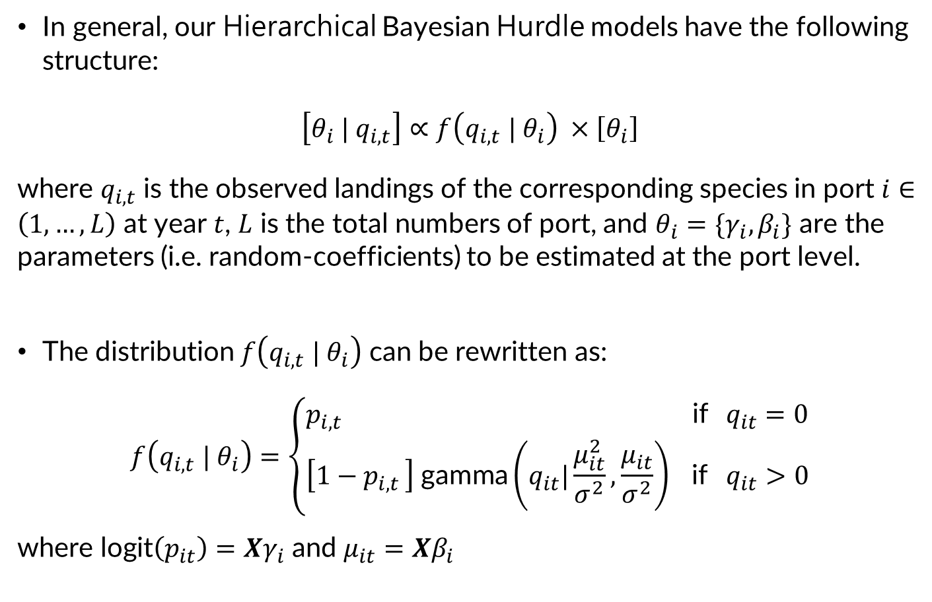
Methodology
In general, our Hierarchical Bayesian Hurdle models have the following structure:
$$\left[θ_{i} | q_{i,t}\right]∝f\left(q_{i,t} | θ_{i}\right) ×\left[θ_{i}\right]$$
where $q_{i,t}$ is the observed landings of the corresponding species in port $i∈\left(1,…,L\right)$ at year $t$, $L$ is the total numbers of port, and $θ_{i}=\{γ_{i},β_{i}\}$ are the parameters (i.e. random-coefficients) to be estimated at the port level.
The distribution $f\left(q_{i,t} | θ_{i}\right)$ can be rewritten as:
$$f\left(q_{i,t} | θ_{i}\right)=\left\{\begin{aligned}p_{i,t } \text{if} q_{it}=0 \\ \left[1−p_{i,t }\right] \text{gamma}\left(q_{it}|\frac{μ_{it}^{2}}{σ^{2}},\frac{μ_{it}}{σ^{2}}\right) \text{if} q_{it}>0\end{aligned}\right.$$
where $\text{logit}\left(p_{it}\right)=Xγ_{i}$ and $μ_{it}=Xβ_{i}$

Slide 24
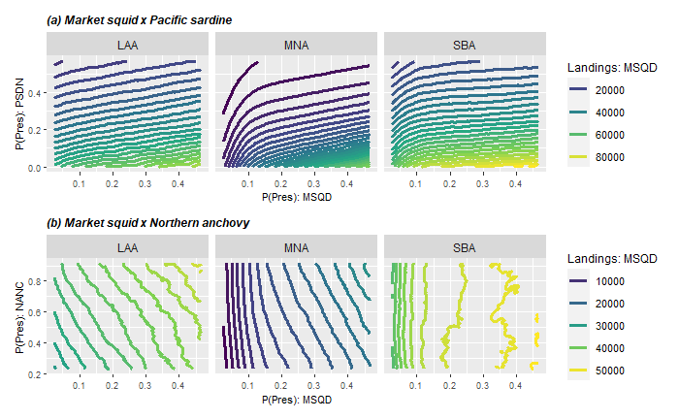
Results: Sardine more preferred than squid

Slide 25
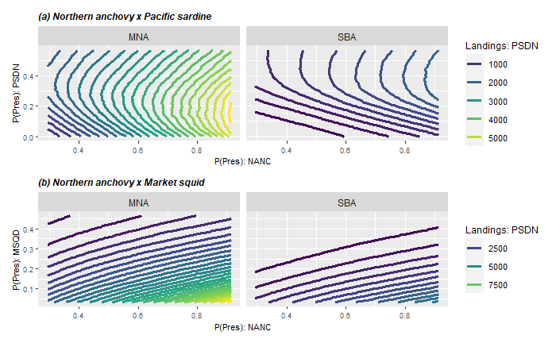
Results: Northern anchovy is less preferred than sardine and squid
NANC
NANC

Slide 26
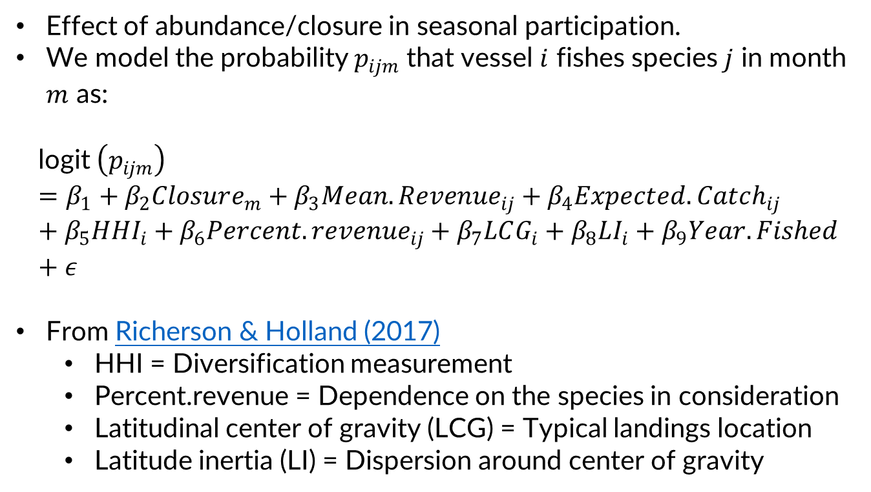
Participation model << No results yet! >>
Effect of abundance/closure in seasonal participation.
We model the probability $p_{ijm}$ that vessel $i$ fishes species $j$ in month $m$ as:
$$\text{l}\text{ogit} \left(p_{ijm}\right)=β_{1}+β_{2}Closure_{m}+β_{3}Mean.Revenue_{ij}+β_{4}Expected.Catch_{ij}+β_{5}HHI_{i}+β_{6}Percent.revenue_{ij}+β_{7}LCG_{i}+β_{8}LI_{i}+β_{9}Year.Fished+ε$$
From Richerson & Holland (2017)
HHI = Diversification measurement
Percent.revenue = Dependence on the species in consideration
Latitudinal center of gravity (LCG) = Typical landings location
Latitude inertia (LI) = Dispersion around center of gravity

